Slide 1

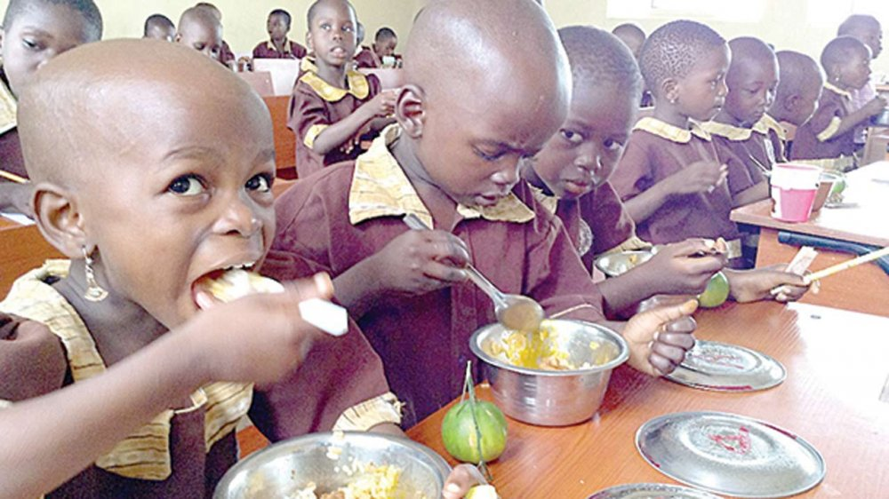
MAKING PRIMARY EDUCATION ATTRACTIVE: QUALITY OF SCHOOL FEEDING PROGRAMME IN TWO SOUTHWESTERN STATES OF NIGERIA
Salami, I. A. and Eze, S. E
Togo, 2022

Slide 2


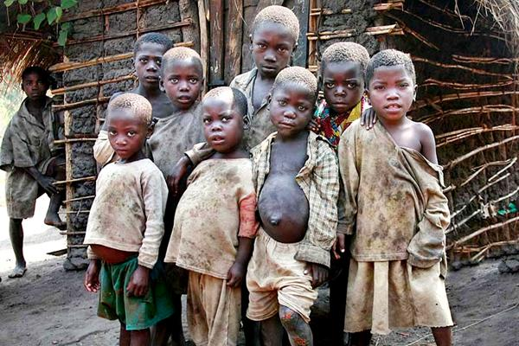
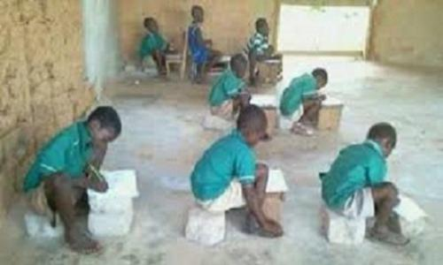
Introduction
Introduction
Lots of happenings in Nigeria lately made school unattractive to children:
1. insurgency
2. COVID-19
3. Increase poverty
4. Poor school resources
and many more
Togo, 2022

Slide 3
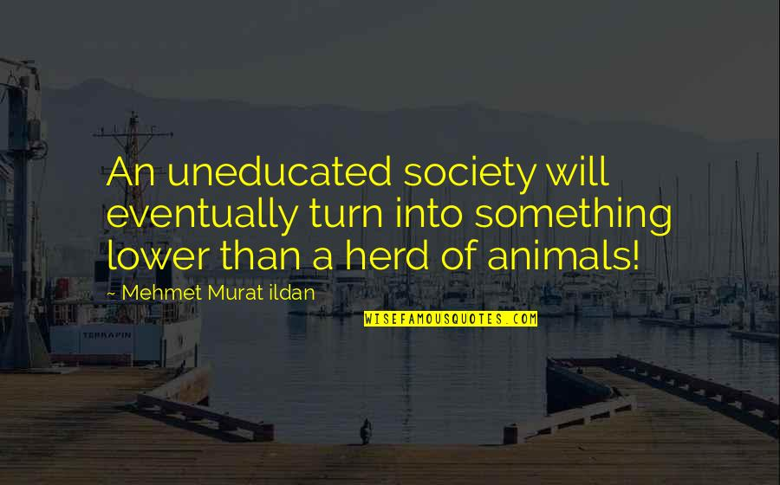
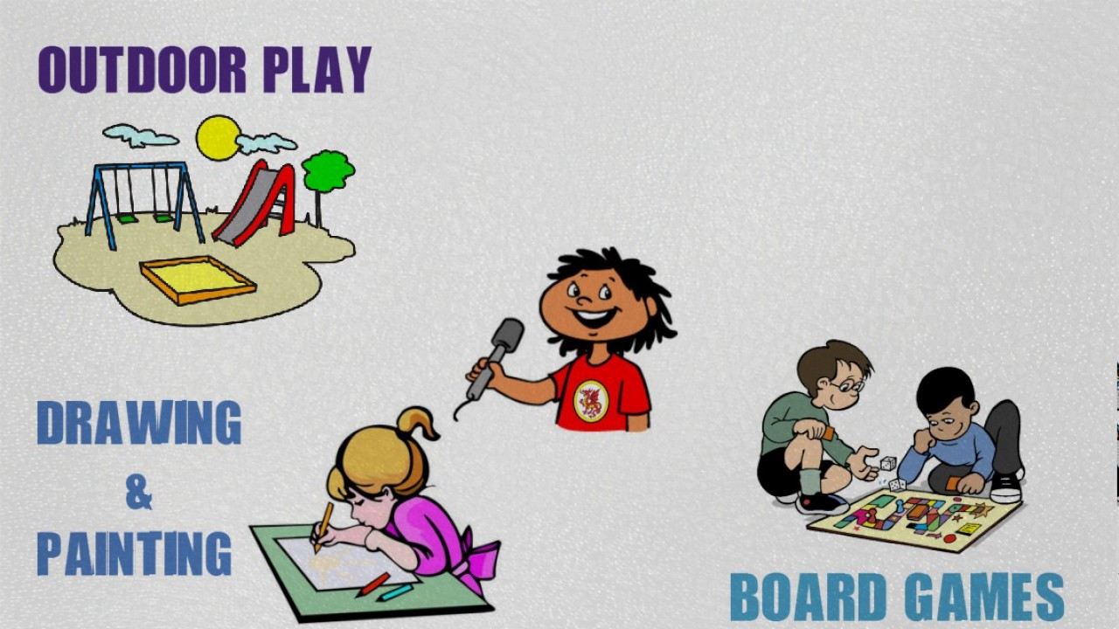
Effects of unattractive
schools to children
Low enrolment rate
Poor attendance rate
Low completion rate
Low learning outcomes
Unachieved Basic Educational goals
increase in future societal problems
Togo, 2022

Slide 4
Then, Introduction of School Feeding Programme (SFP)
To Increase School:
Enrolment
Attendance
Consequently to Enhance:
Learning outcomes
Completion rate
Togo, 2022

Slide 5

MAJOR CHALLENGE FACING SFP IN NIGERIA
STATE-BASED IMPLEMENTATION, IN TERMS OF:
Financing (UNICEF; WFP; PCD; FG; SG etc)
Staffing and collaboration
Quality and quantity of food
Accessment rate
Monitoring and Supervision
Togo, 2022

Slide 6

State-based implementation made SFP success varies according to State
One of the 12 states where SFP was piloted in 2005 is Osun State and recorded highest success
SFP started in Oyo State in January, 2017
SFP in Oyo State seems facing many challenges based on observations and stakeholders reactions
Togo, 2022

Slide 7
The major reason
why Osun and Oyo
were compared
in the implementation
of SFP
“
Togo, 2022

Slide 8
Osun and Oyo States in a Context
Creation: Both came to existence in 1991
Population 2022: Osun (4,705,589) Oyo (7,840,864)
IGR 2020(N): Osun (19.67 billion) Oyo (38.04 billion)
No of primary schools 2019: Osun (3,339) Oyo (6,368)
The SFP programme in Osun has successful records than Oyo State
Togo, 2022

Slide 9
Theoretical Background
CIPP model of Evaluation
Stufflebeam evaluates
The Context
The Input
The process
The product
In this study
We evaluates
The objective of SFP
The finance, quality and quantity of food
The collaborations, monitoring and supervision
The assessibility by the chiildren
Togo, 2022

Slide 10
Materials and Methods
A QUAN + qual type of Triangulation
Multi-stage sampling to select
180 teachers
150 parents
2 state coordinators
Three research instruments were used
Perception of Parents about Quality of SFP (0.75);
Perception of teachers about SFP (0.71) and
State Coordinator of SFP Interview guide
Togo, 2022

Slide 11
Results
Perception of parents towards quality School Feeding Programme (SFP) as a solution to major problem of basic education is positive
The teachers have positive perception about the efficacy of SFP to solve huger problem facing basic education
But Teachers’s perception about the quality implementation of the programme in the states is negative.
Togo, 2022

Slide 12
Quantity and Quality of SFP
Out of a scale of 4.0
Osun State teachers rated the quality and quantity of SFP to be 2.61.
Oyo State teachers rated quality and quantity of SFP to be 2.31
Hence, Osun provides better quality and quantity of SFP compared to Oyo
Togo, 2022

Slide 13
Quantity and Quality of SFP
Osun State inspects and monitors
Using
Parents
Community
School Business man
Government officials
Every Month
Oyo State inspects and monitors
Using
Government officials
Every Month
Togo, 2022

Slide 14
Access of SFP
Osun State feeds
All primary schools, rural and urban
Primary I to IV (OSG feeds Pry IV)
Communities supports
PTA supports
Other agencies supports
Oyo State feeds
Primary schools, mostly urban
Primary I to III only
No other support
Togo, 2022

Slide 15
Conclusion
Osun State implements SFP better and attracts children to school more.
This is made possible through
Better commitment
collaboration and
Inspection and supervsion.
Oyo State, or any other state that is not implementing SFP right, should take a leave from Osun State
Togo, 2022

Slide 16
Recommendations
Oyo State should adopt partnership approach in the implementation of SFP across the State.
The two State should try to support by feeding the upper primary classes. This could be achieved by investing in community food production.
The food should be served as a breakfast on the basis of ‘first come, first serve’ to discourage lateness.
Togo, 2022

Slide 17
Togo, 2022

